Slide 1

Anjuman Polytechnic, Sadar, Nagpur-01
Title: Follow Me Kart
Group Members:-
Abishai Shankpal R.No 04
Anmoldeep Singh Arora R.No 07
Rohitraj R. Juriasinghani R.No 17
Sanskar Dwiwedi R.No 18
Project Guide:-
Mr. Anwar Ahsan Sir, HoD, CO dept.

Slide 2
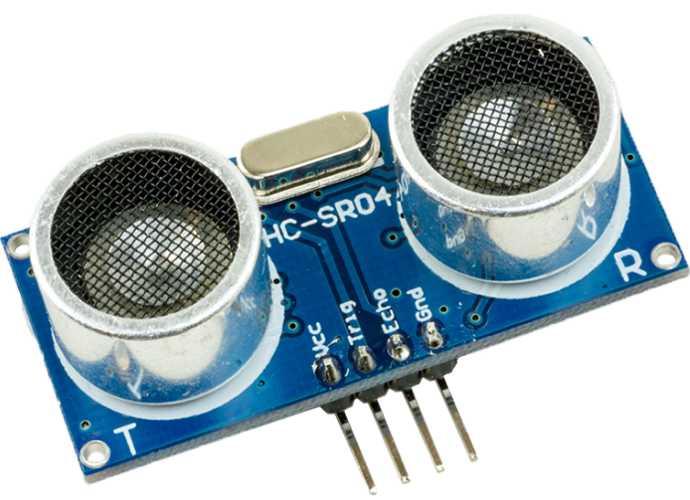
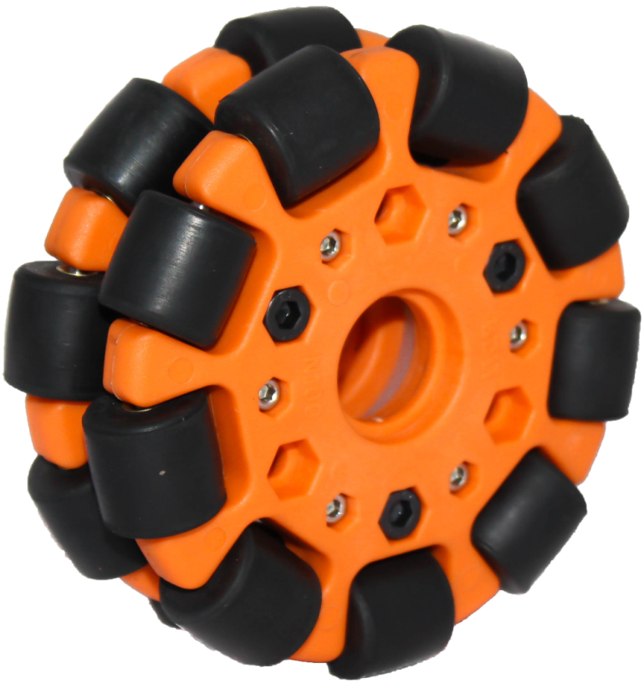
Contents
Introduction
Methodology
Proposed System
Working
Advantages
Applications
Future Expansion

Slide 3

Introduction:
Nowadays, supermarkets are pervasive in our lives.
However, the experience of using shopping carts may be inconvenient
Current human powered Carts are too tedious to use while shopping or chatting with nearby person
As there is a high demand for using shopping cart in supermarkets, these unsolved problems have inspired us to improve the current technology of using carts and therefore create a niche for innovation to address.

Slide 4
Methodology
Often for moving little heavy or bulky things around, we use trolley/ Cart.
The Traditional Shopping Cart or just Cart becomes too difficult to use when filled with heavy items
Moving Cart and choosing items to shop simultaneously, results in increased time requirement.
Challenging for physically challenged, expecting women, and\or people in a hurry.

Slide 5
Proposed System
An autonomous Cart which follows the user from behind.
While moving around, the Cart analyses distance and heading and moves towards the user.
Heading is calculated and Motors are powered to perform the “Follow Me” action.
An optional feature “Kill” button can be used to keep the cart at rest.

Slide 6
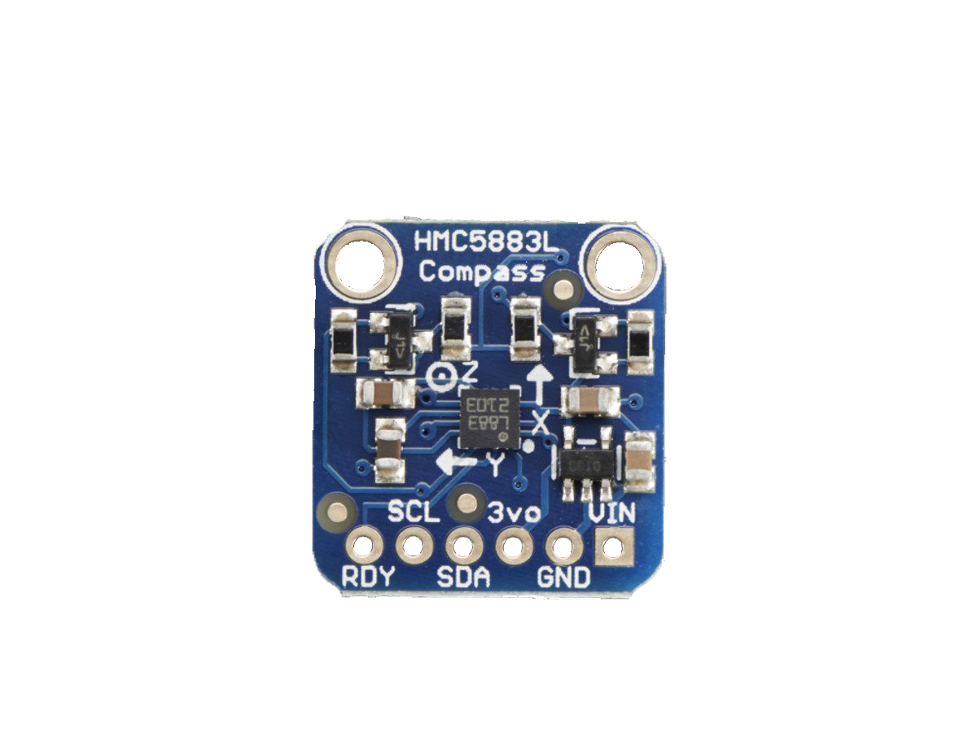
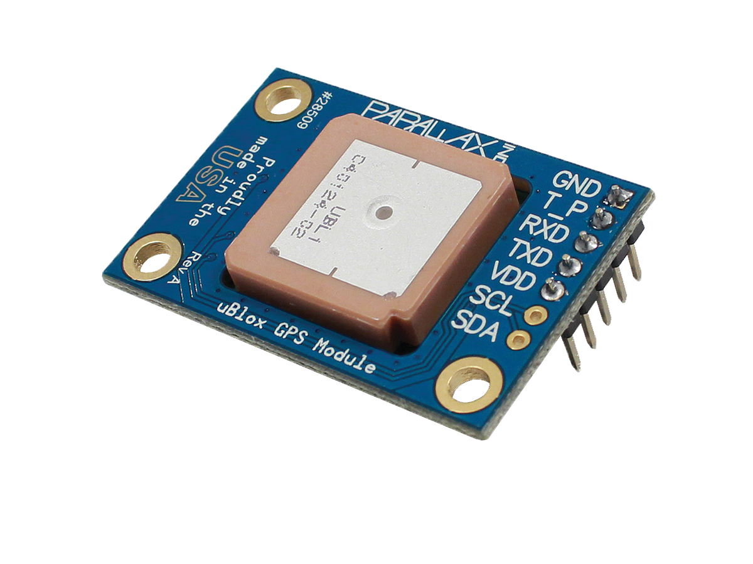
Working
Navigation using:
HMC5883L Compass Module.
Sensing using:
PAM-7Q GPS Module(GPS).
HMC 5883L compass module
Pam 7Q GPS module

Slide 7
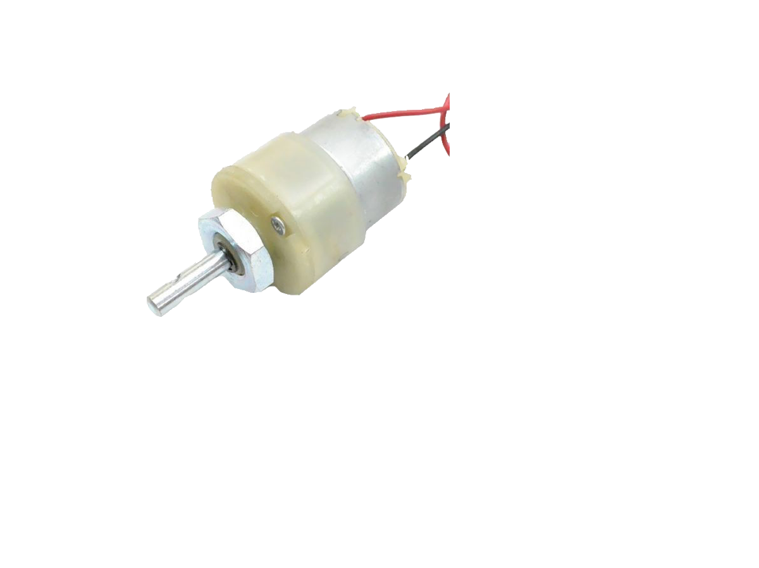
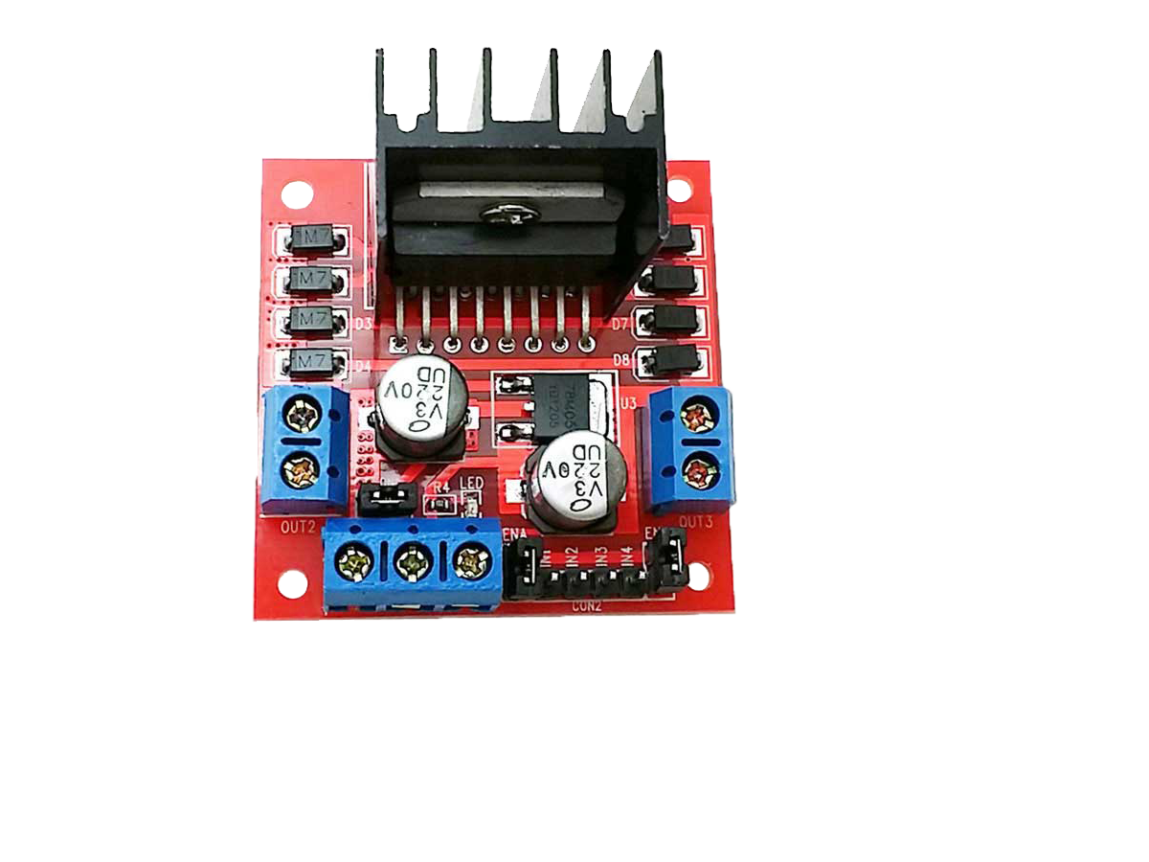
Working
Turning system: DC geared motor center shaft (12v) and L298N motor driver module.
DC 12v geared Motor
L298N motor driver

Slide 8
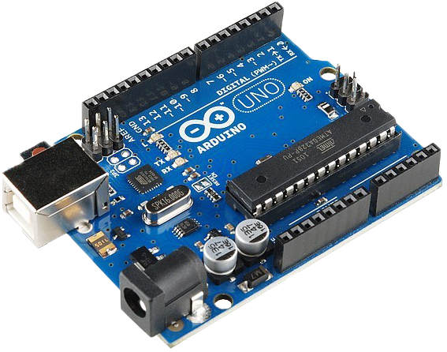
Working
Processing system:
Using Arduino main board
Arduino

Slide 9
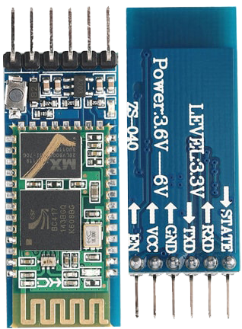

Working
Connectivity using:
Bluetooth and Blynk app.
HC-05 Bluetooth module

Slide 10
Advantages
Saving efforts of dragging cart around.
Convenient and easy to control.
Can easily handle load of 30kg-50kg.
Connects to any Android or iOS Smartphone.
Can be guided via simple joystick interface too for complex paths.
Easy diagnosis, troubleshooting and debugging via internal terminal widget.

Slide 11
Application
Super Markets
Hospitals
Airports
Railway Stations
Goods storage units
Military Canteens
Any other possible application.

Slide 12


Future Expansion
Can use Wi-Fi or Internet for connectivity.
Can use
Omni wheel
instead of
standard wheels.
Omni Wheel

Slide 13
Future Expansion
Can use Proximity sensor for collision avoidance

Slide 14
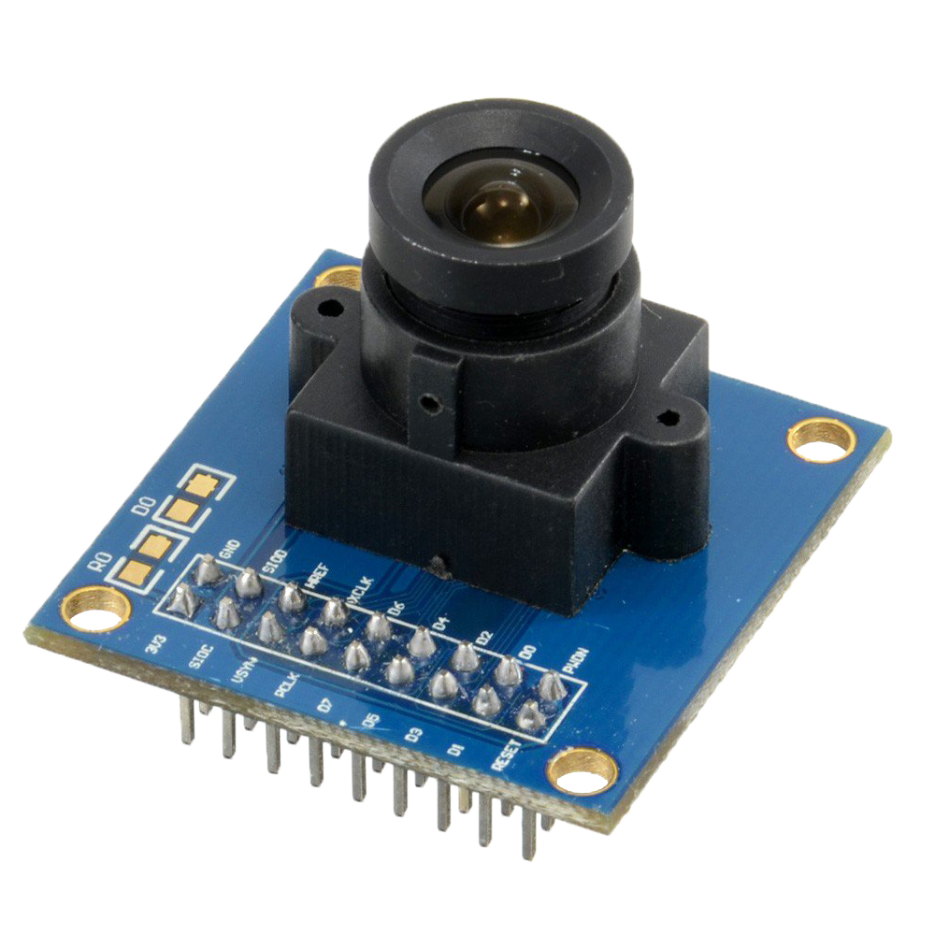
Future Expansion
Can use camera
module for
user Detection

Slide 15
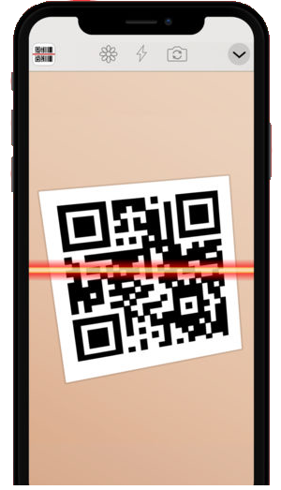
Future Expansion
Can use QR
authentication

Slide 16
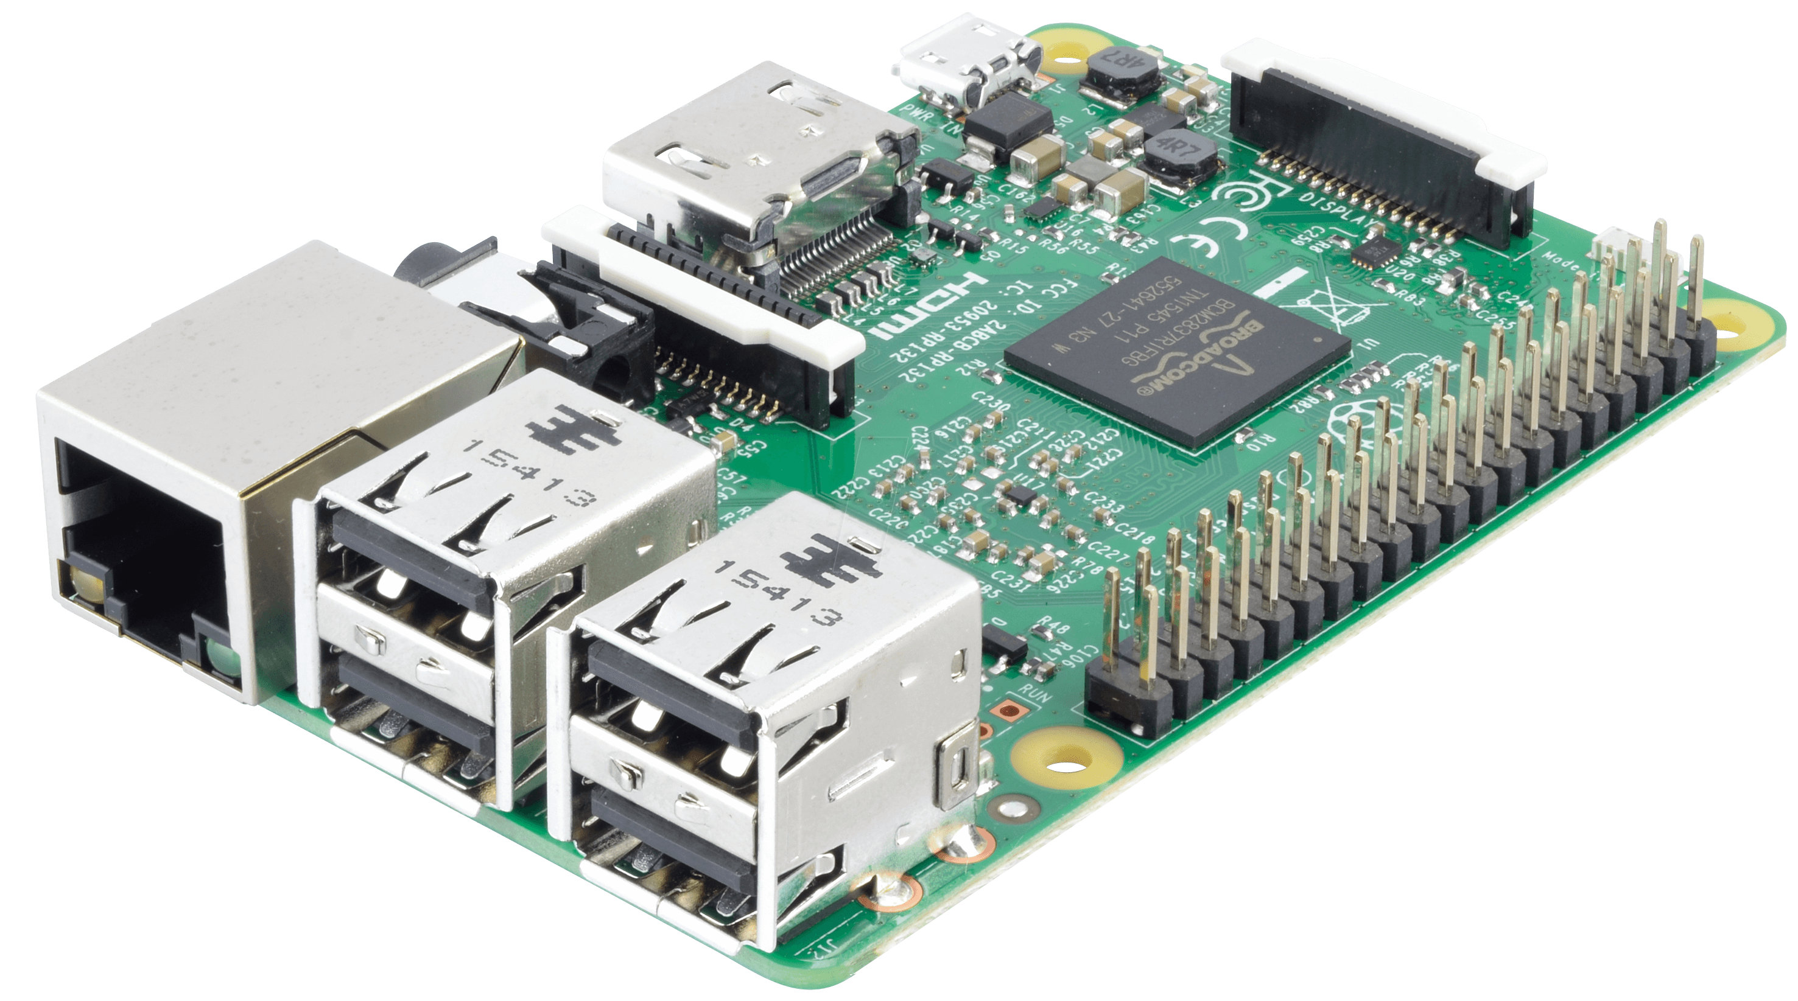
Future Expansion
Can use
Raspberry Pie

Slide 17

“The Future will outshine the past, where the present is smiling at the change.” -Anmoldeep

